Slide 1
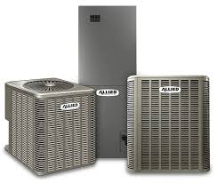

Allied Air Enterprises: Marketing Support
Background
Allied Air is a Lennox International company that manufactures and supplies premier heating, ventilation, and air conditioning (HVAC) solutions for residential and commercial use. They operate through multiple brands, such as Armstrong Air, AirEase, and Allied Commercial.
They were looking for an ongoing marketing & CRM partner to audit and provide implementation services.
Affirma Support:
Social Media Management
  Performed comprehensive audit with competitor analysis
  Created organic strategy
  Deployed weekly posts across several channels
Salesforce Pardot / CRM
  Email nurture strategy
  Email deployments
  Segmentation strategy
  Email and landing page creation
  Lead management process
  Creative design support
  Ad-hoc admin
Notes:
Alyson

